Slide 1
PROBABILITY THEORY
MTM2592-Gr:2
11TH WEEK
Assc. Prof. Dr. Ulku (BABUSCU) YESIL
ubabuscu@yildiz.edu.tr
ulkubabuscu@gmail.com
https://avesis.yildiz.edu.tr/ubabuscu

Slide 2
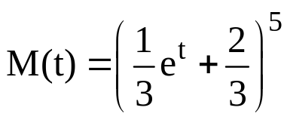

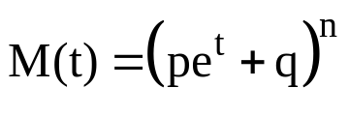
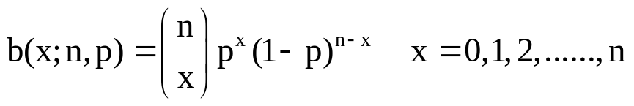
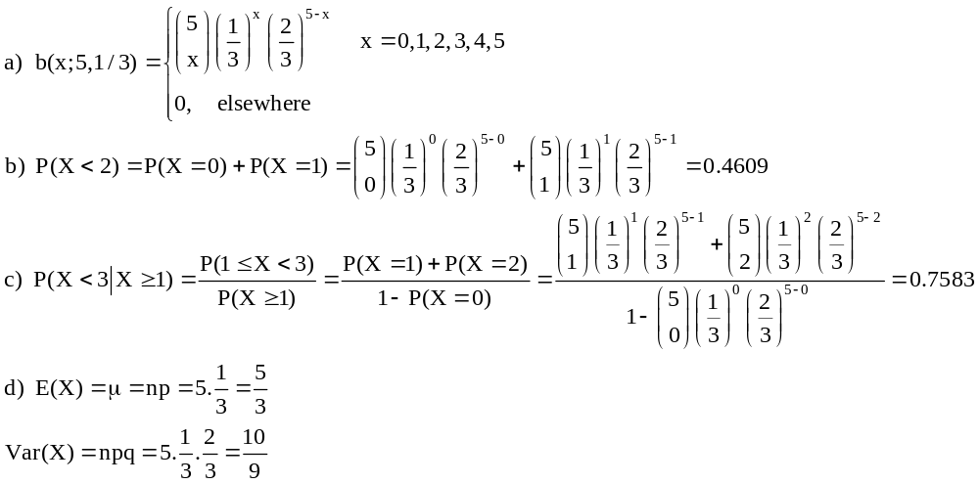
Example: Moment generating function of a X random variable is given below.
Find the probability function of X,
Find P(X<2),
Find
Find E(X) and Var(X).
Binomial distribution

Slide 3
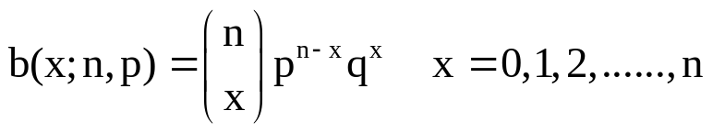
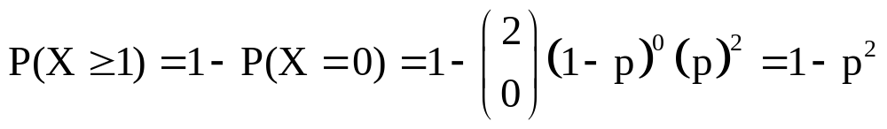
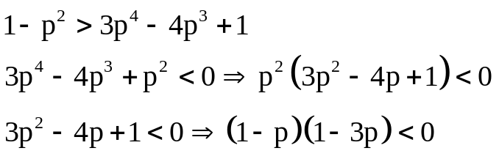
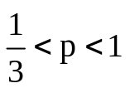
Example: Let p be the probability of failure of an aircraft engine. At least half of their engines must be running before an aircraft can complete its flight. For which value of p, 2 engine aircraft are preferred over 4 engine aircraft?
X: numbers of running engines
n: total number of engines
For two-engines aircraft, probability of running at least an engine;
For four-engines aircraft, probability of running at least two engines;
For the choice of 2 engines aircraft,

Slide 4
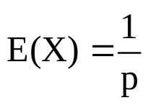
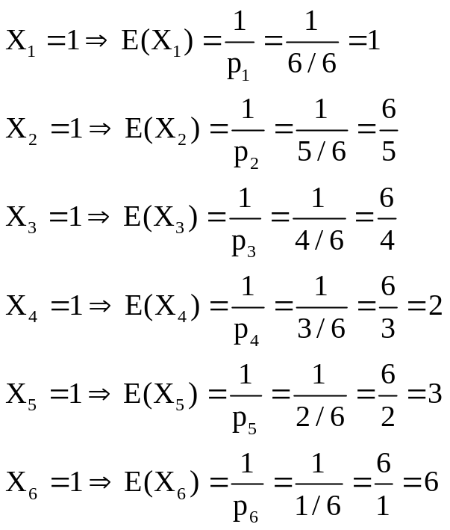
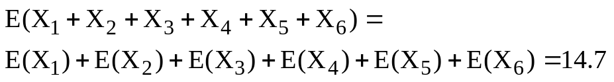
Example: A dice is rolled until all of its faces are visible. Find the expected value of the number of rolling.
X₁: the number of rolling until the first different number comes
X₂: the number of rolling until the second different number comes
X₃: the number of rolling until the third different number comes
X₄: the number of rolling until the fourth different number comes
X₅: the number of rolling until the fifth different number comes
X₆: the number of rolling until the sixth different number comes
Geometric distribution

Slide 5
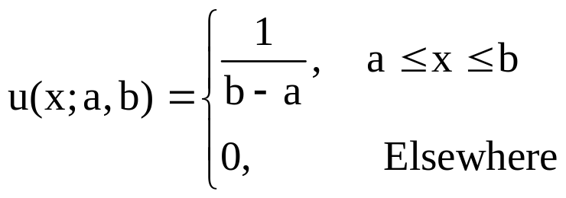
SPECIAL PROBABILITY DENSITIES
If the random variable X is continuous, the distribution of probabilities for X is called continuous distribution. The probability function of continuous distributions is called probability density function.
THE CONTINUOUS UNIFORM DISTRIBUTION
Definition: A random variable X has a uniform distribution and it is referred to as a continuous uniform random variable if and only if its probability density is given by

Slide 6
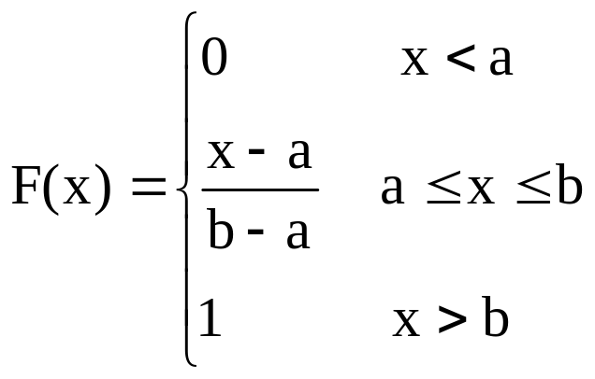
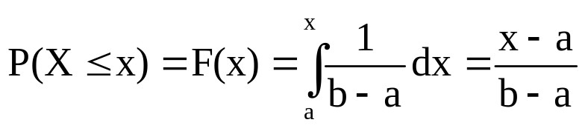
Cumulative probability function or distribution function of uniform distribution;

Slide 7
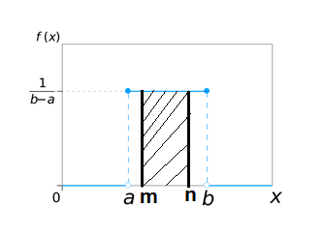
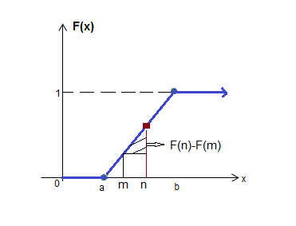

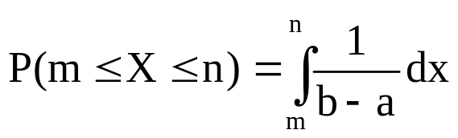

a) The continuous uniform distribution’s probability density function
b) The continuous uniform distribution’s cumulative probability density function
If then the probability that the X random variable with a uniform distribution is in a given range
or by using cumulative probability function
This probability is equal to the shaded areas in the graphics given above.

Slide 8
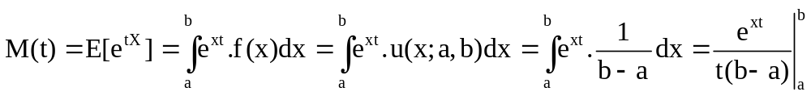
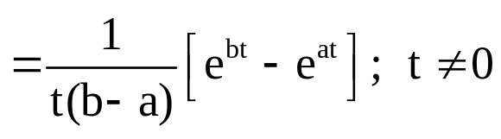
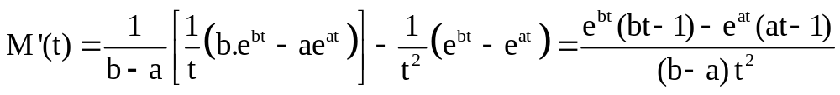
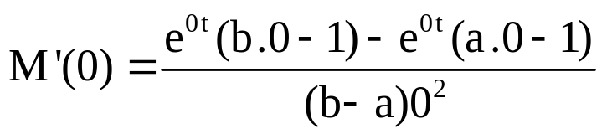
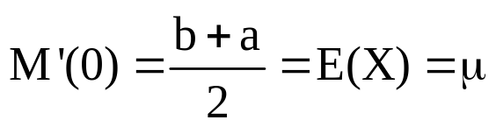
Moment Generating Function, Expected Value and Variance Of The Continuous Uniform Distribution
a) By using the definition of moment generating function;
If L'Hopital is applied twice;

Slide 9
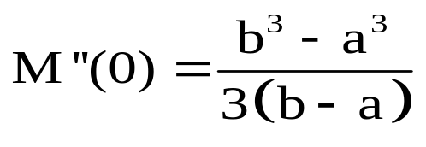
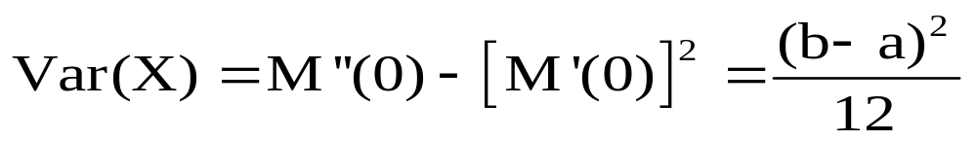
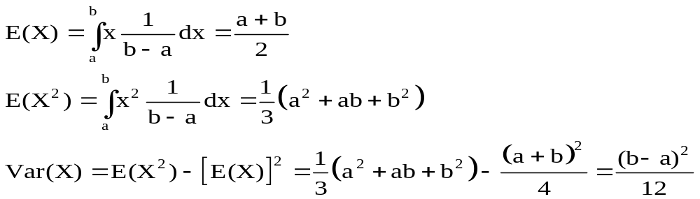
By using the definition of the expected value and variance,

Slide 10
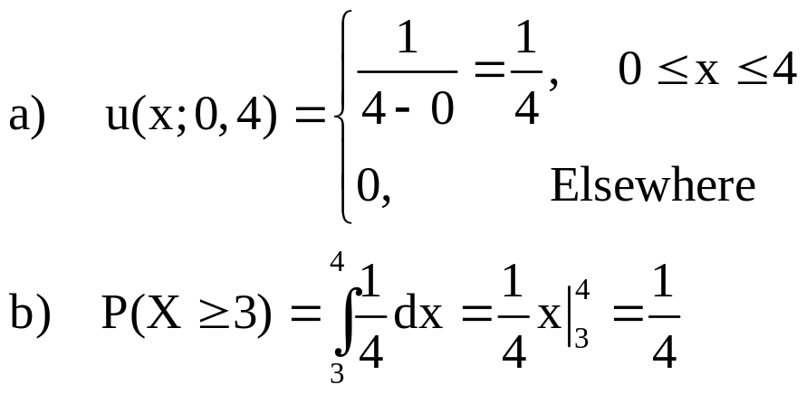
Example: Let a conference room can be reserved for no more than 4 hours. If we assumed that the duration X of a conference has a uniform distribution,
What is the probability density function?
What is the probability that any given conference lasts at least 3 hours?
Solution:

Slide 11
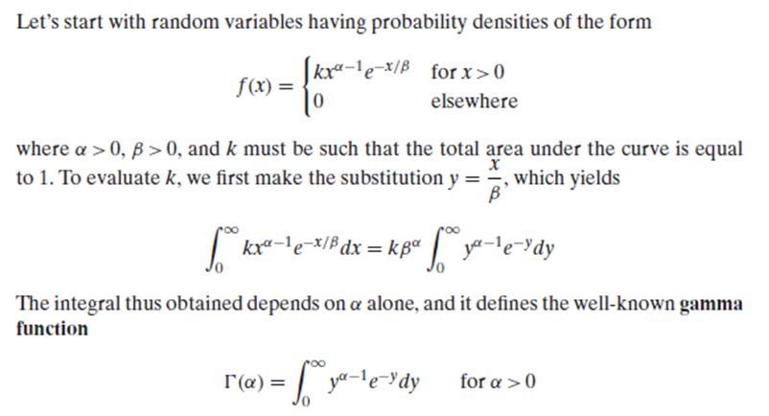
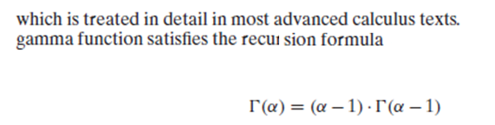
2. THE GAMMA, EXPONENTIAL AND CHI-SQUARE DISTRIBUTIONS

Slide 12

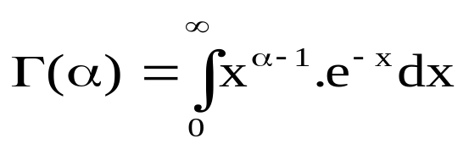
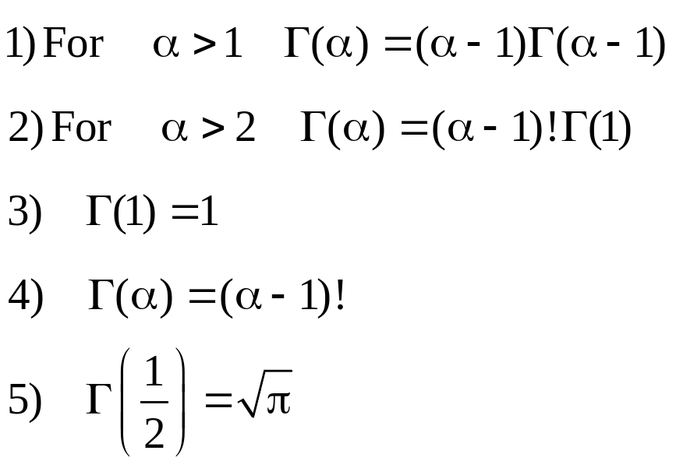
Definition: If
Properties of Gamma Function:

Slide 13
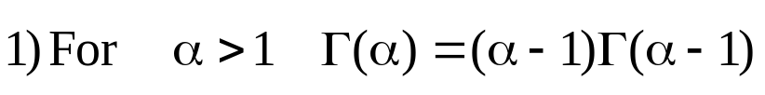

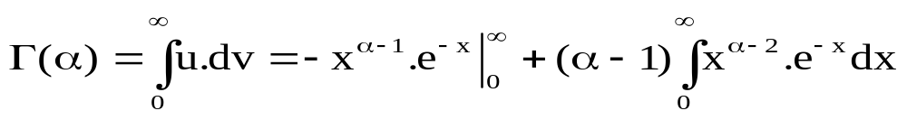

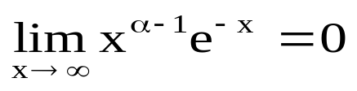

Proofs:

Slide 14
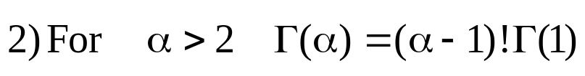
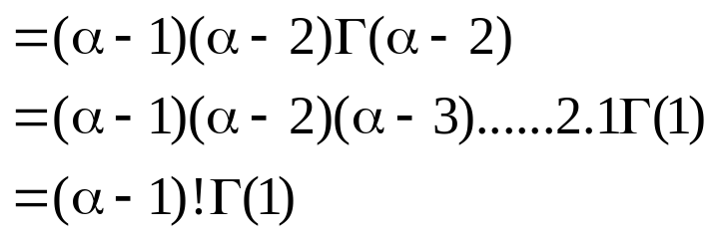
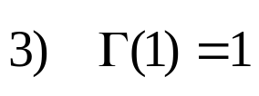
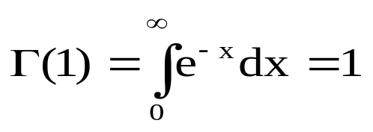
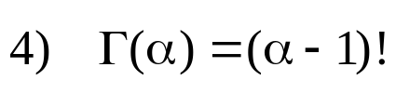
The first property can be applied sequentially to demonstrate the accuracy of this equation.
Using property 2 and 3, property 4 is obtained.

Slide 15
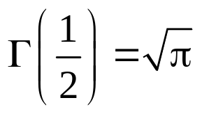
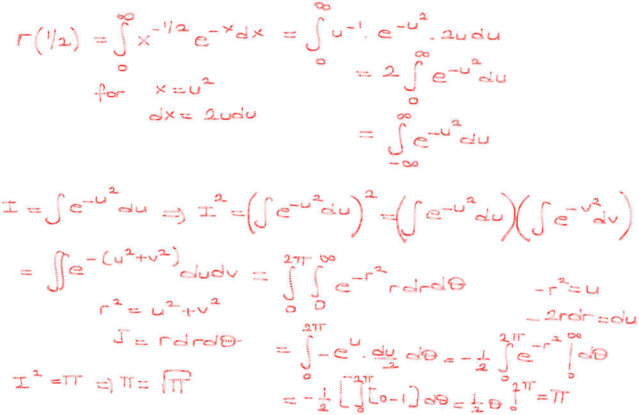


Slide 16
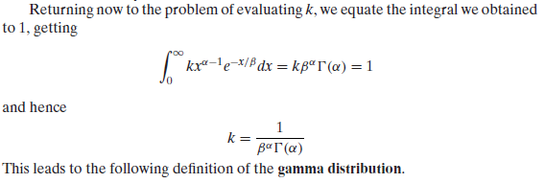

Slide 17
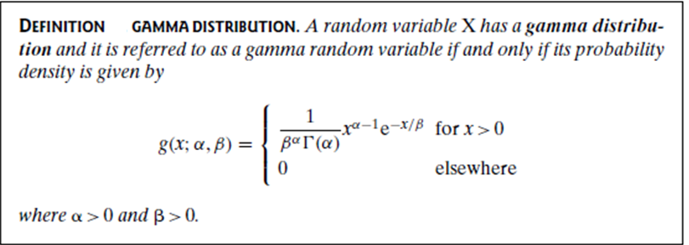
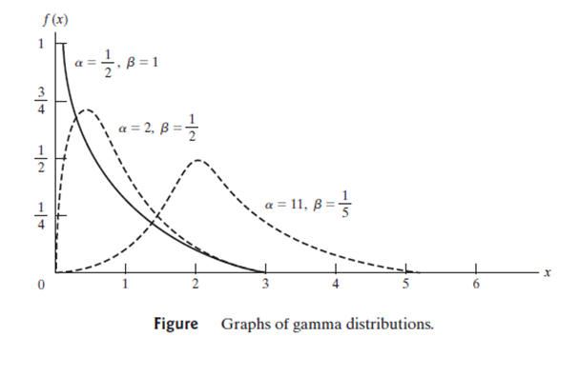

Slide 18

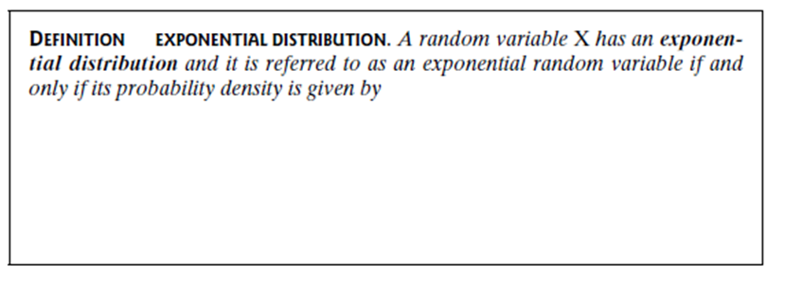
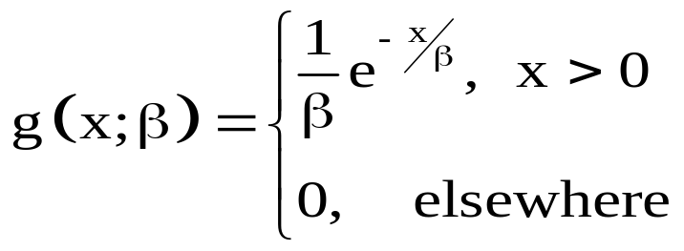

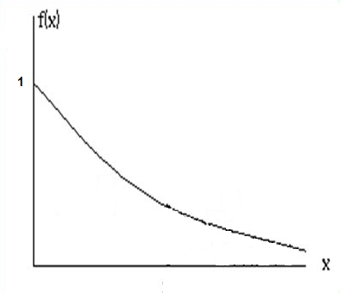
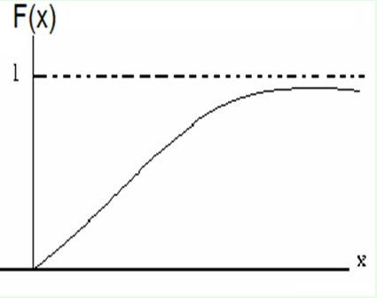
The special gamma distribution for which α=1 is called the exponential distribution. (β is the mean)
Probability Density Function b) Cumulative Probability Density Function

Slide 19

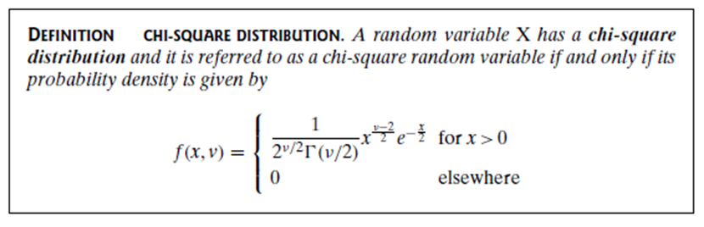

The special gamma distribution for which
is called Chi-Squared distribution.

Slide 20
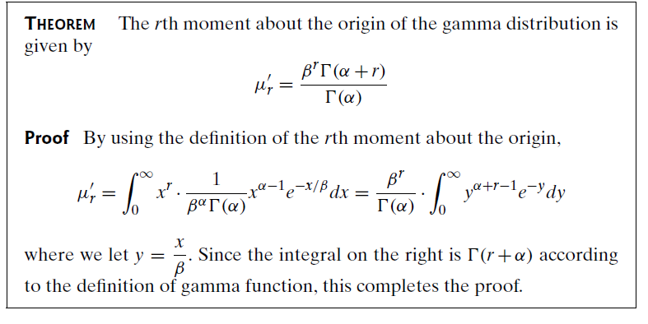
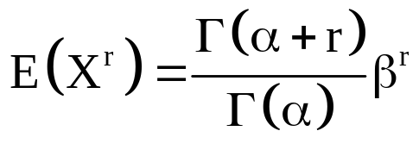

Slide 21


Slide 22



Slide 23



Moment Generating Function, Expected Value and Variance Of The Gamma Distribution
a) By using the definition of moment generating function;

Slide 24





b) By using the definition of the expected value and variance of an X random variable,

Slide 25






In the moment generating function, expected value and variance of the gamma distribution, by writing for the exponential distribution, the moment generating function, the expected value and variance can be calculated.
In the moment generating function, expected value and variance of the gamma distribution, typing , the moment generating function, expected value and variance can be calculated for the chi-square distribution.
For gamma distribution;
For exponantial distribution;
For chi-square distribution;

Slide 26



Slide 27




Example: If X is a random variable of the exponential dist. with β=1/2, find the cumulative distribution function of X and calculate
Solution:

Slide 28


Example: The hourly working time (without breakdown) of electronic devices produced in a factory has an exponential distribution. If the mean of working time without breakdown is 24 hours, then
Find the probability that a randomly selected device will work at least 12 hours,
Find the probability that a randomly selected device will work at most 36 hours,
Find the mean of these devices’ working time in order to be probability that a selected device works more than 30 hours is 0.80.
Solution:

Slide 29


We use the symbol to denote the variable x in the chi-square distribution.
We use chi-square table in order to determine the ares of the shaded region.
Total area is 1.

Slide 30



Example: For the chi-square distribution with , find
Solution:

Slide 31


Slide 32


Slide 33
THE RELATIONSHIP OF THE EXPONENTIAL DISTRIBUTION WITH THE POISSON PROCESS
Let's consider there is the probability of getting x successes during a time interval of length t when
i) The probability of a success during a very small time interval from t to t+Δt is α. Δt ,
ii) The probability of more than one success during such a time interval is negligible, and
iii) The probability of a success during such a time interval does not depend on what happened prior to time t.
The number of successes is a value of discrete random variable X having the Poisson distribution with λ=α. t. Let us determine the probability density of the continuous random variable Y, the waiting time until the first success. Clearly,

Slide 34






Note that, if β is considered as
the mean of time interval between two customers, taxis, etc…
the mean of distance between two defects, item,etc…
Then the random variable X with exponential distribution can be considered as
the time interval between two customers,taxis, etc…
the distance between two defects, items,etc…
Now we will explain the relationship between Poisson and Exponential distribution:
The probability that there is no item between (0,n)
If we take X=n for exp. Dist.
The number of items
between the distance (time)
[0,n]
If β=1/p, then X represents the time between two items.

Slide 35


Slide 36






Example: The number of buses passing from a bus stop in an hour has a Poisson distribution. If averagely 24 buses pass from a bus stop in an hour, find the probability that a passanger waits at most 5 minutes by using
Poisson dist.
Exponential dist.
Solution: a)

Slide 37



3. BETA DISTRIBUTION
A random variable X has a beta distribution and it is referred to as a beta random variable if and only if its probability density is given by
where

Slide 38




It is often used as a model for rates. The beta function is shown as
There is a relationship between beta function and Gamma function.

Slide 39








Expected Value and Variance of Beta Distribution
By using the definition of expected value and variance;

Slide 40





Slide 41

Example: It is known that a certain amount of a pool evaporates in one day because of the air temperature. If this amount can be modeled with beta distribution with α=5 and β=2;
Find the expected value of this amount,
What is the probability of at least 20% of the pool evaporates on a very hot day?
Solution:

Slide 42

Example: Daily electricity consumption in a city has a gamma distribution with mean=6 and variance=12,
Find the values of α and β,
What is the probability of electricity consumption exceeding 12 million kilowatt hours on any given day?
Solution:

Slide 43












Example: Daily water consumption in a city has a gamma distribution with α=2 and β=3. If the city's daily water capacity is 9 million liters of water, what is the probability that the water supply is insufficient on a given day?
Solution:

Slide 44

Example: The time taken to serve a single person in a cafeteria is a random variable with an exponential distribution of β=4 minutes. What is the probability that a person will receive service in less than 3 minutes in at least 4 of the next 6 days?
Solution:
Y: the number of days a person received service in less than 3 minutes

Slide 45


Example: In a large restaurant serving self-service, an average of 4 customers come every 5 minutes.
Find the probability of no customer coming in 5 minutes,
Find the probability of a maximum of 2 minutes between two consecutive customers
Find the probability that the time between two customers is more than 3 minutes

Slide 46


Slide 47

Example: A city bus comes to bus station every 15 minutes from 07:00 in the morning. Ali is known to arrive at this bus station in any minute between 07:00 and 07:30. The time until the bus comes after arriving at the bus station is a random variable with continuous uniform distribution
a) Find the probability of waiting the bus in less than 5 minutes
b) Find the probability of waiting the bus for more than 12 minutes

